Slide 1
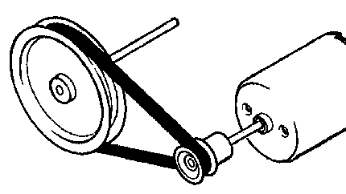
Trade related Calculations
Rim speed, pulleys & Band saw blade lengths
Math 1435 Math Fundamentals
This Photo by Unknown Author is licensed under CC BY-SA-NC

Slide 2
Rim Speed
Rim speed definition: The peripheral rate of travel of a blade or cutter head expressed in lineal feet per minute (LFM).
Rim speed is quite simply measuring the speed at which the outside cutting circle of a cutter head is traveling.
Most cutting tool manufacturers will specify the optimum rim speed for each of their cutting tools. These speeds are calculated to ensure safety and integrity of the cutting tool.
The optimum rim speed for woodworking cutter heads is 14,000 lfm.
Proper rim speeds will reduce heat build up, prolong cutter life and improve the surface quality.
Other factors to think about: Species of wood and feed speed.

Slide 3
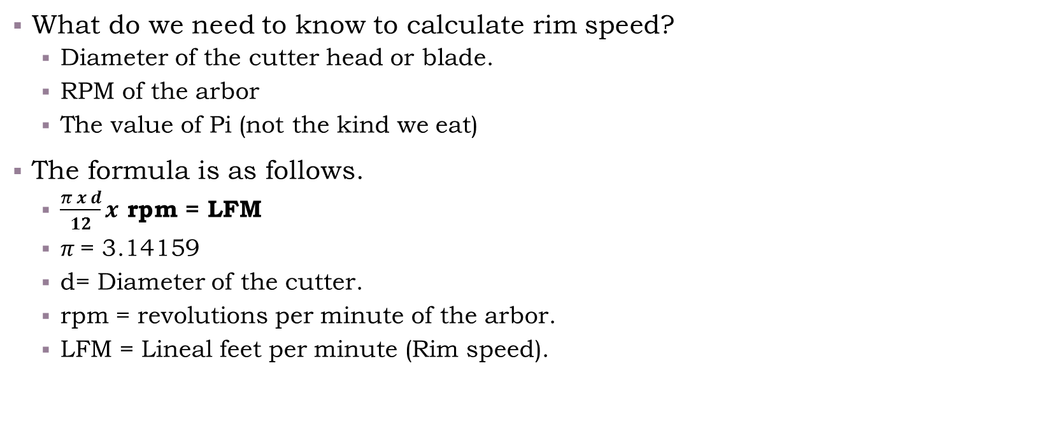
Rim speed calculations
What do we need to know to calculate rim speed?
Diameter of the cutter head or blade.
RPM of the arbor
The value of Pi (not the kind we eat)
The formula is as follows.
$\frac{π x d}{12}x$ rpm = LFM
$π$= 3.14159
d= Diameter of the cutter.
rpm = revolutions per minute of the arbor.
LFM = Lineal feet per minute (Rim speed).

Slide 4
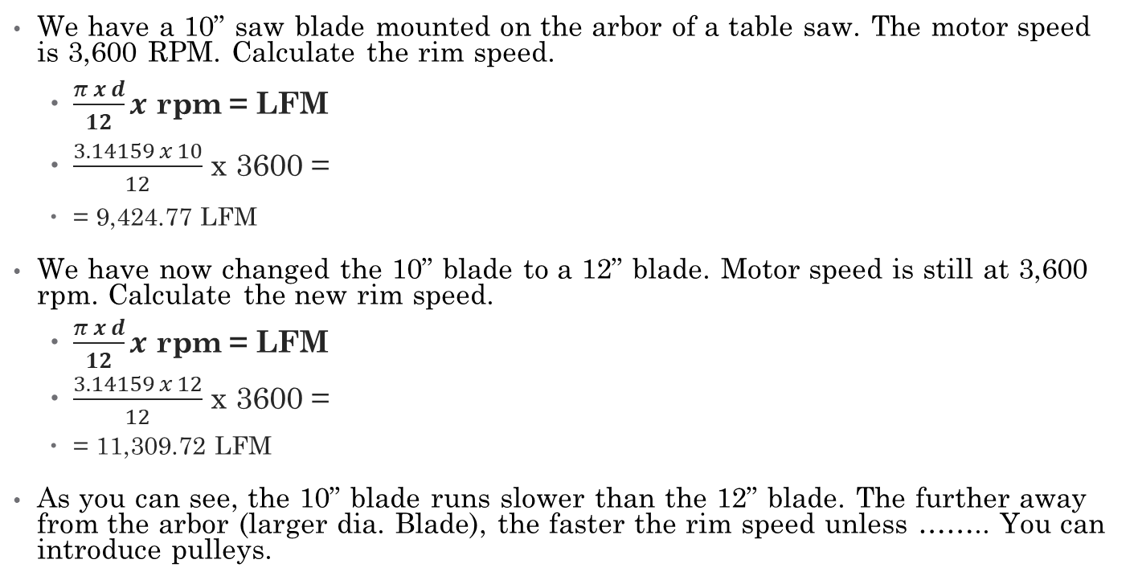
Rim Speed Example
We have a 10” saw blade mounted on the arbor of a table saw. The motor speed is 3,600 RPM. Calculate the rim speed.
$\frac{π x d}{12}x$ rpm = LFM
$\frac{3.14159 x 10}{12}$ x 3600 =
= 9,424.77 LFM
We have now changed the 10” blade to a 12” blade. Motor speed is still at 3,600 rpm. Calculate the new rim speed.
$\frac{π x d}{12}x$ rpm = LFM
$\frac{3.14159 x 12}{12}$ x 3600 =
= 11,309.72 LFM
As you can see, the 10” blade runs slower than the 12” blade. The further away from the arbor (larger dia. Blade), the faster the rim speed unless …….. You can introduce pulleys.

Slide 5
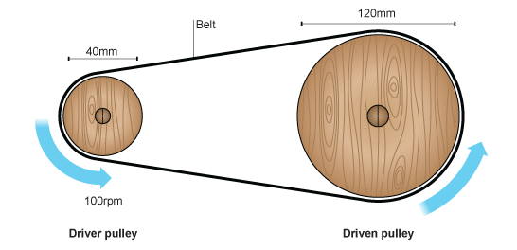
Pulleys

Slide 6
Pulleys Cont.
We can use pulleys to either speed up or slow down arbors.
We achieve this by altering the size of the pulleys in relation to each other.
To try to understand pulleys, think of them as car tires. Compare a car with 12” tires and a car with 17” tires. If both cars drive the same distance, the 12” tire will need to make more revolutions than the 17” tire.
Perimeter = xd
12” x 3.14159 = 37.699”
17” x 3.14159 = 53.407”
The 12” tire would have to make 1.416 revolutions for every 1 revolution of the 17” tire.

Slide 7
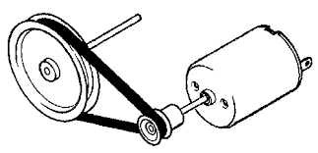
Pulley ratio calculation
To calculate the pulley ratio we:
Divide the driving pulley diameter (attached to the motor) by the driven pulley diameter (attached to the arbor).
Take the factor we just calculated and multiply it by the motor RPM to get the new arbor RPM.
Now calculate the new Rim speed of the cutter head.

Slide 8
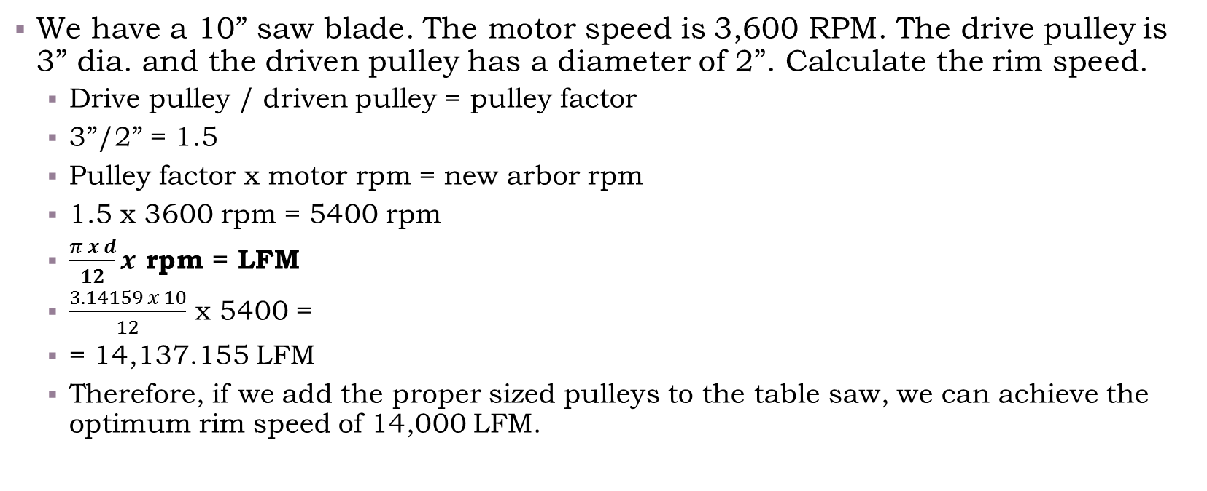
Pulley calculation example
We have a 10” saw blade. The motor speed is 3,600 RPM. The drive pulley is 3” dia. and the driven pulley has a diameter of 2”. Calculate the rim speed.
Drive pulley / driven pulley = pulley factor
3”/2” = 1.5
Pulley factor x motor rpm = new arbor rpm
1.5 x 3600 rpm = 5400 rpm
$\frac{π x d}{12}x$ rpm = LFM
$\frac{3.14159 x 10}{12}$ x 5400 =
= 14,137.155 LFM
Therefore, if we add the proper sized pulleys to the table saw, we can achieve the optimum rim speed of 14,000 LFM.

Slide 9
Pulley calculation example B
What if we know the motor speed, blade diameter and recommended rim speed. How do we find the pulley sizes to reach the recommended rim speed.
Example
Motor speed = 1750 rpm
Blade dia. = 12”
Recommended rim speed = 14,000 LFM
Pulley sizes available: 2”, 2-1/2”, 3”, 3-1/2”, 4”, 4-1/2”, 5”, 6”, 7”, 8”.
What pulley combination should we use to achieve the 14,000 LFM rim speed?

Slide 10
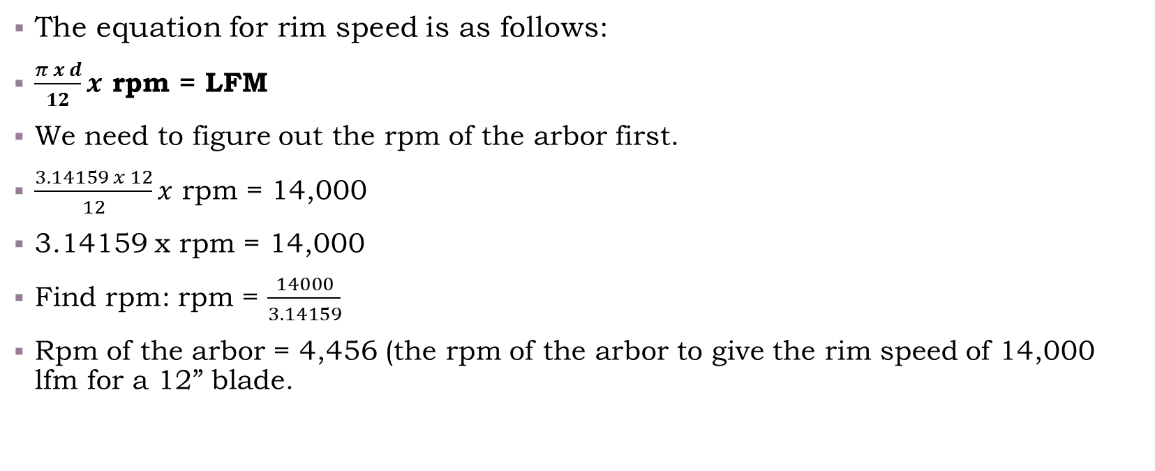
Pulley calculation example B cont.
The equation for rim speed is as follows:
$\frac{π x d}{12}x$ rpm = LFM
We need to figure out the rpm of the arbor first.
$\frac{3.14159 x 12}{12}x$ rpm = 14,000
3.14159 x rpm = 14,000
Find rpm: rpm = $\frac{14000}{3.14159}$
Rpm of the arbor = 4,456 (the rpm of the arbor to give the rim speed of 14,000 lfm for a 12” blade.

Slide 11
Pulley calculation example B cont. page 3
Now we know the rpm’s of the motor (1750 rpm) and the rpm’s of the arbor (4456 rpm) to reach the required rim speed.
Now we must find the pulley ratio value. To do so, we must use Pulley Ratio = Drive/ driven.
Divide the Drive rpm by the Driven rpm, this will show the missing part of the ratio
1750 ÷ 4456 = 0.3927289048473968
Pulley ratio = 1 (motor) to 0.3927--- (arbor)
Now find the 2 pulley sizes where 1 pulley is 0.3927--- x’s smaller than the other.
5” x 0.3927--- = 1.963644----” (or 2”)
Therefore, if we use a 5” pulley (motor) and a 2” pulley (arbor) with a 1750 rpm motor the rim speed of the 12” blade would be very close to14,000 lfm.

Slide 12
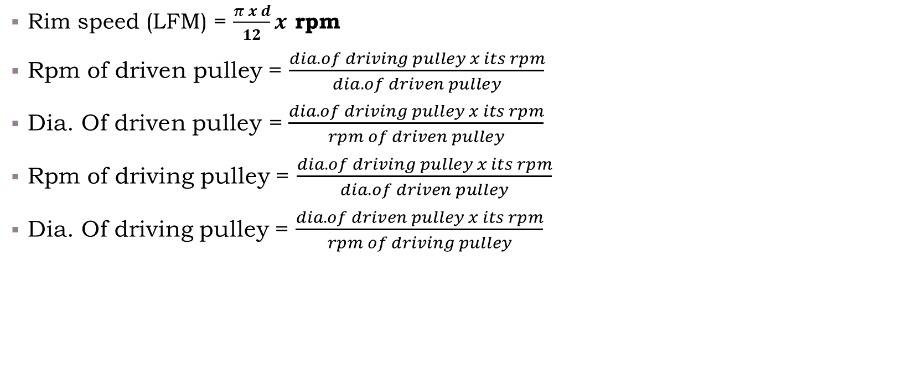
Pulley formulas
Rim speed (LFM) = $\frac{π x d}{12}x$ rpm
Rpm of driven pulley = $\frac{dia. of driving pulley x its rpm}{dia. of driven pulley}$
Dia. Of driven pulley = $\frac{dia. of driving pulley x its rpm}{rpm of driven pulley}$
Rpm of driving pulley = $\frac{dia. of driving pulley x its rpm}{dia. of driven pulley}$
Dia. Of driving pulley = $\frac{dia. of driven pulley x its rpm}{rpm of driving pulley}$

Slide 13
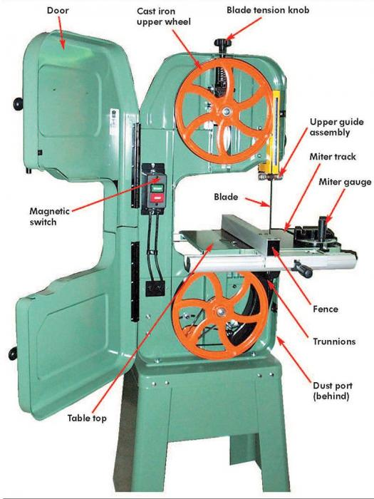
Bandsaw blade length calculations
To calculate the required length of a two wheel band saw blade, we must have the following information:
Diameter of wheels
Length between the centers of the band saw wheels
Value of  (3.14159)
The formula is : ( x d) + (2 x center to center dist.)

Slide 14
Bandsaw example
A bandsaw has 18” diameter wheels and a center-to-center distance of 50”. What length of blade is required.
= ( x d) + (2 x center to center dist.)
= (3.14159 x 18) + (2 x 50)
= (56.5486) + (100)
= 156.5486”
Or 156-½” length blade is required. (calculate to the nearest ¼”)

Slide 15
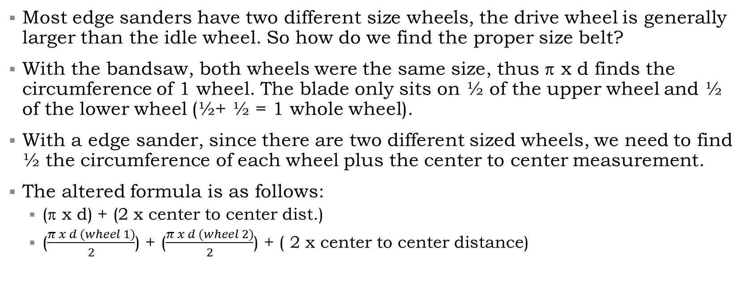
Sanding belt calculations
Most edge sanders have two different size wheels, the drive wheel is generally larger than the idle wheel. So how do we find the proper size belt?
With the bandsaw, both wheels were the same size, thus  x d finds the circumference of 1 wheel. The blade only sits on ½ of the upper wheel and ½ of the lower wheel (½+ ½ = 1 whole wheel).
With a edge sander, since there are two different sized wheels, we need to find ½ the circumference of each wheel plus the center to center measurement.
The altered formula is as follows:
( x d) + (2 x center to center dist.)
($\frac{π x d (wheel 1)}{2}$) + ($\frac{π x d (wheel 2)}{2}$) + ( 2 x center to center distance)

Slide 16
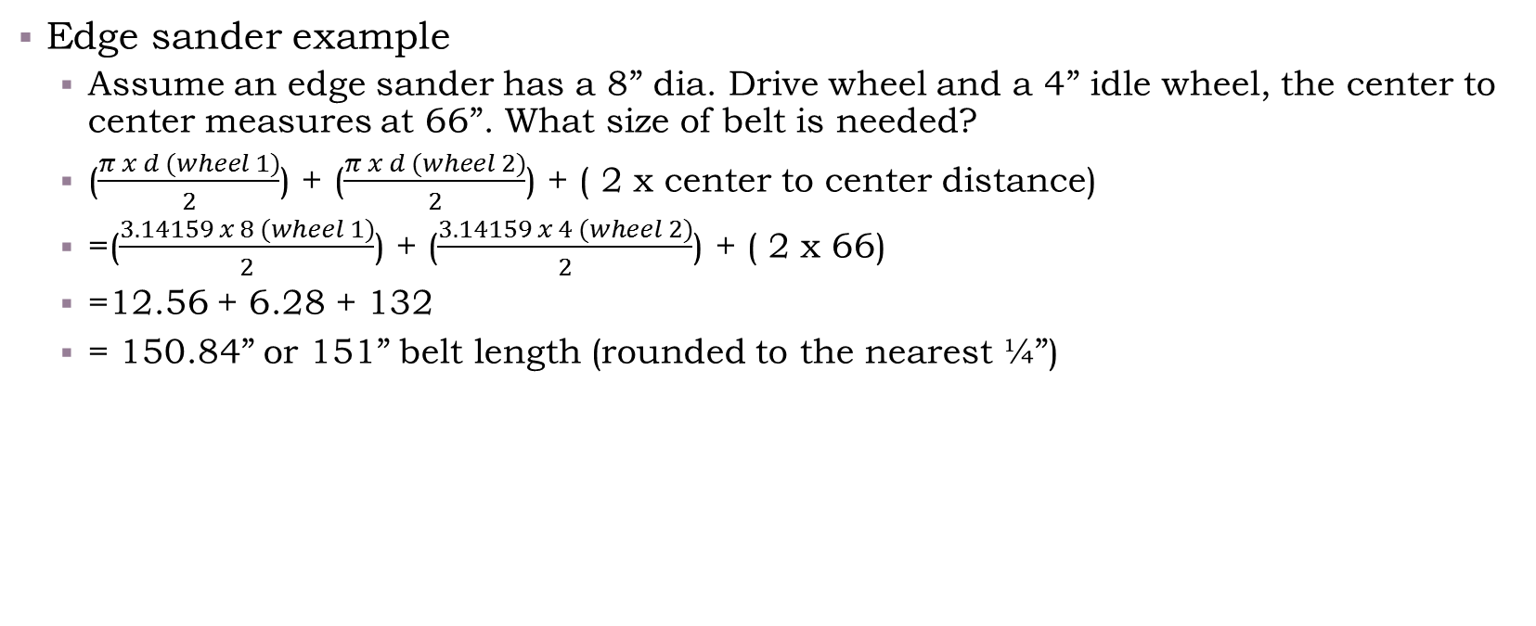
Edge sander calculation
Edge sander example
Assume an edge sander has a 8” dia. Drive wheel and a 4” idle wheel, the center to center measures at 66”. What size of belt is needed?
($\frac{π x d (wheel 1)}{2}$) + ($\frac{π x d (wheel 2)}{2}$) + ( 2 x center to center distance)
=($\frac{3.14159 x 8 (wheel 1)}{2}$) + ($\frac{3.14159 x 4 (wheel 2)}{2}$) + ( 2 x 66)
=12.56 + 6.28 + 132
= 150.84” or 151” belt length (rounded to the nearest ¼”)

